Slide 1
Using PowerShell to work with HDInsight

Slide 2
What is Azure PowerShell?

Slide 3
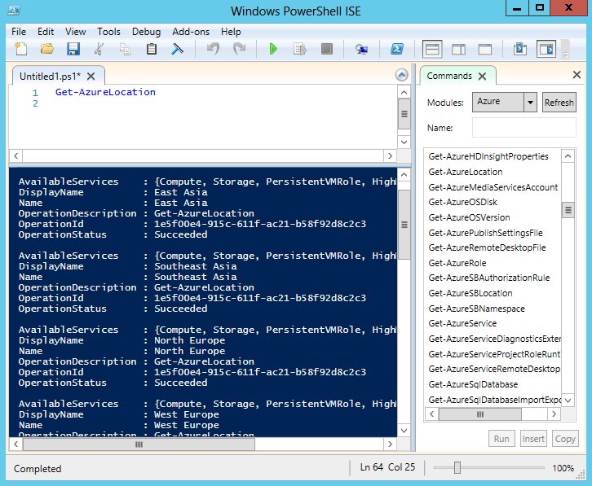
PowerShell is a command interface and scripting engine for Windows (and beyond)
The Azure PowerShell module includes cmdlets to work with Azure services, including HDInsight
Install Azure PowerShell using the Microsoft Web Platform Installer

Slide 4

Connect PowerShell to your Azure subscription
Download and import a certificate
Use Azure AD
Access services in multiple subscriptions
Specify subscription in cmdlet parameters
Set subscription context
Get-AzurePublishSettingsFile
Import-AzurePublishSettingsFile "<file_path>"
Add-AzureAccount
Select-AzureSubscription
Notes:
You can open a remote desktop connection to your HDInsight cluster and use the command line tools installed there to work with HDInsight; but in most scenarios, an easier (and more secure) way to work with HDInsight is to use Windows Azure PowerShell cmdlets on a local computer. Windows Azure PowerShell is a library of programmable classes that you can use to manage all aspects of Windows Azure, including provisioning services and virtual machines, managing data in Windows Azure storage containers, and running MapReduce jobs in Windows Azure HDInsight.
Before you can use Windows Azure PowerShell, you must prepare the local PowerShell environment by performing the following steps:
Download and install Windows Azure PowerShell. You can download Windows Azure PowerShell by using the Web Platform Installer, which is available from the Windows Azure downloads page at www.windowsazure.com.
Connect your Windows Azure subscription to the local PowerShell environment. Before you can run local PowerShell commands that manipulate your Windows Azure services, you must associate PowerShell on the local computer with your Windows Azure subscription.
Connecting PowerShell to a Windows Azure Subscription
There are two approaches you can use to connect PowerShell to your Windows Azure subscription:
Download and import a certificate from Windows Azure.
Authenticate using Windows Azure Active Directory (AD).
The certificate-based option imports a certificate that is valid for a year, and makes it easy to manage Windows Azure services from PowerShell for long periods of time without the need to re-authenticate. However, it can be difficult to manage certificates when multiple users will access the same subscription from different computers.
Windows Azure AD authenticates individual users based on their Microsoft account credentials, and grants access for a period of 12 hours. This approach makes it easier for multiple users to access the subscription, since no certificate must be downloaded and managed, but can disrupt long-running operations because of the need to re-authenticate periodically.
Using a Certificate
To use certificate-based authentication from PowerShell to Windows Azure, download and import the publishsettings file from your Windows Azure subscription. The publishsettings file includes the credentials necessary to authenticate you when connecting to Windows Azure. To import this file into a Windows Azure PowerShell session, run the Get-AzurePublishSettingsFile PowerShell cmdlet. If you do not already have an open browser session to your Windows Azure account, PowerShell will launch one and prompt you to sign in using your Microsoft account credentials, and then initiate the download of a certificate file. Ave the file in a secure location on your computer, and then use the Import-PublishSettingsFile cmdlet to import the certificate into PowerShell.
The following example shows how to download and import the publishsettings certificate file.
Get-AzurePublishSettingsFile
# PowerShell opens a browser and prompts you to download the .publishsettings file.
Import-AzurePublishSettingsFile "C:\Downloads\Azure-1-1-2013-credentials.publishsettings"
The publishsettings file contains sensitive information. After importing it into your PowerShell environment, you should delete the file or store it somewhere secure.
Using Windows Azure AD
As an alternative to downloading and importing the publishsettings file, you can use the Add-AzureAccount cmdlet to connect to your Windows Azure account. When you run the Add-AzureAccount cmdlet, the Windows Azure PowerShell environment opens a web page in which you can sign in using the Microsoft account associated with your Windows Azure subscription.
The following example shows how to use Windows Azure AD to authenticate with Windows Azure from PowerShell:
Add-AzureAccount
Using and Managing Accounts and Subscriptions
A single account can be associated with multiple Windows Azure subscriptions. You can use the following PowerShell cmdlets to manage accounts and subscriptions:
Get-AzureAccount. This cmdlet lists the Windows Azure accounts you have added to PowerShell using Add-AzureAccount.
Get-AzureSubscription. This cmdlet lists the Windows Azure subscriptions that are associated with your PowerShell environment.
Remove-AzureAccount. Use this cmdlet to remove a Windows Azure account that is no longer valid or required.
Remove-AzureSubscription. Use this cmdlet to remove a Windows Azure subscription that is no longer valid or required.
When you connect a PowerShell environment to Windows Azure you can include multiple accounts and subscriptions. One subscription is designated as the default subscription, and is used when a subscription is not explicitly specified when running a Windows Azure cmdlet. Most cmdlets include a subscription parameter that enables you to specify the subscription in which the cmdlet should be run, and you can also use the Select-AzureSubscription cmdlet to control the subscription context of your PowerShell scripts.

Slide 5
Installing and Configuring Azure PowerShell

Slide 6
How do I use Azure PowerShell to manage an HDInsight cluster?

Slide 7


Determine available storage account and cluster names
Test-AzureName
Create a storage account
New-AzureStorageAccount
Create a container
Get-AzureStorageKey
New-AzureStorageContext
New-AzureStorageContainer
Create an HDInsight cluster
New-AzureHDInsightCluster

Slide 8
Delete an HDInsight cluster
Remove-AzureHDInsightCluster
Delete the storage account if no longer required
Remove-AzureStorageAccount

Slide 9
Managing an HDInsight Cluster with PowerShell

Slide 10
How do I use Azure PowerShell to manipulate files?

Slide 11
Get the Azure Storage key
Get-AzureStorageKey
Create the Azure Storage context
New-AzureStorageContext
Upload local files to blobs in Azure
Set-AzureStorageBlobContent
Download Azure blobs to local files
Get-AzureStorageBlobContent

Slide 12
Uploading and Downloading Files with Azure PowerShell

Slide 13
How do I use Azure PowerShell to run a MapReduce job?

Slide 14
Create a job definition
New-AzureHDInsightMapReduceJobDefinition
Submit the job
Start-AzureHDInsightJob
View the job execution information
Wait-AzureHDInsightJob
Get-AzureHDInsightJobOutput
Notes:
MapReduce jobs are usually implemented as executable components that you upload to the cluster. These components can be written in a wide range of programming languages, including Java, Microsoft C#, JavaScript, and Python. After you have uploaded a MapReduce component to the cluster, you can run it by using Windows Azure PowerShell.
Running a MapReduce Job
After you have prepared the Windows Azure PowerShell environment, you can use a MapReduce component that you have uploaded to the HDInsight cluster to run a MapReduce job. There are two steps required to accomplish this:
Use the New-AzureHDInsightMapReduceJobDefinition command to define the job you want to run. This command creates a job definition that includes the location of the component, the class in the component to be used, and the arguments required to execute the job. Jobs usually require two arguments: the location of the source files to be processed by the job, and the folder where the results should be saved. Locations in HDFS are specified using the Windows Azure storage protocol (in which a wasb:// prefix is used).
Use the Start-AzureHDInsightJob command to run the job on a specified cluster in a specified subscription. The following sample code shows how to use the wordcount class in the hadoop-examples.jar component provided with HDInsight to process the davinci.txt sample file.
$clusterName = "MyHDInsightCluster"
$jobDef = New-AzureHDInsightMapReduceJobDefinition
-JarFile "wasb:///example/jars/hadoop-examples.jar"
-ClassName "wordcount"
-Arguments "wasb:///example/data/Gutenberg/davinci.txt", "wasb:///example/data/output"
$wordCountJob = Start-AzureHDInsightJob
-Cluster $clusterName
-JobDefinition $jobDef
MapReduce jobs can take a long time to complete, so you should use the following technique to check for completion and view the results:
Use the Wait-AzureHDInsightJob command to check for completion, as shown in the following example:
$wordCountJob | Wait-AzureHDInsightJob -WaitTimeoutInSeconds 3600
When the job state is reported as Completed, use the Get-AzureHDInsightJobOutput command to check for any errors as shown in the following code example.
Get-AzureHDInsightJobOutput
-Cluster $clusterName
-JobId $wordCountJob.JobId
-StandardError

Slide 15
Running a MapReduce Job with PowerShell

